Slide 1
BUSINESS COMMUNICATION
Writing process
&
Business message
BBA 2106

Slide 2
The Process of Writing
Writing researches have been studying the composing process since the 1970’s.
They found that that each person’s way of developing a piece of writing for a given situation is unique.
Familiarizing with the findings will help to make one’s more deliberate, effective writer.

Slide 3
The Process of Writing
 The writing process consists of three main stages.
Planning,  Drafting,  Revising.
There are interrelations among these stages.
These are recursive.
A Model of writing process
Planning
Gathering and collecting
Analyzing and organizing
Choosing a form
Drafting
Being Flexible
Keeping going
Using your own favorite strategies
Revising
Revising contents, structure, and format
Editing sentences and words
Proofreading

Slide 4
The Process of Writing
For example:
A writer in the planning stage may start writing pieces of the draft.
Or s/he may find when drafting, that more gathering of information is necessary.
Or s/he may decide that it’s necessary to revise a piece of the document carefully before continuing on with the drafting.
A common mistake that writers make is to spend too much time on drafting and too little on the other two stages, planning and revising.
Once one becomes an expertise in business writing, s/he may be able to write many routine messages without as much planning and revising.

Slide 5
Planning the Message
In the planning segment, it needs to think about your own organizational, professional , and personal contexts and their possible impact on communication goal.
Once it’s chosen the message’s purpose, it needs to figure out the best way to achieve it.
 Most people, before drafting, have at least some sense of how they want to handle these elements.

Slide 6
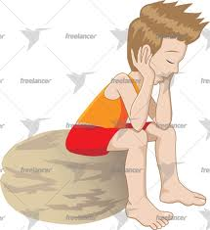
Planning the Message
 We might group all these planning activities into three categories:
Gathering and collecting information;
Analyzing and organizing the information; and
Choosing the for, channel, and format it will take.

Slide 7
Planning the Message
☞ Gathering and collecting information:
Gathering information means doing some research.
In some cases the research can be informal- Findings past correspondence
Consulting with other employees or with outside advisors
Getting records
Product or service descriptions

Slide 8
Planning the Message
 Collecting information by using
 Memory
 Imagination, and
 Creativity is also important.
Visualizing the readers and bearing their interests in mind in an excellent planning technique.
Making a list of pertinent facts is helpful.
Brainstorming, or generating possible solutions without censoring them, it will allow to come up with creative solutions.

Slide 9
Planning the Message
☞ Analyzing and Organizing Information:
Once one has a good number of ideas, it will start to assess them.
If the data are numerical, it will do the calculations that will enable to see patterns and meaning in the numbers.
There are also a guide a number for organizing the information.
Regardless of the situation, all readers appreciate a logical pattern for the information.

Slide 10
Planning the Message
☞ Choosing a Form, Channel, and Format:
 Writers in school typically produce writing in two types:
 Essay
 Research Papers
Each form has its own formatting and stylistic conventions, and even conventions about content.
Business writers do not launch into writing in a document without some sense of what kind of document it will be.
On the job, choosing the type of document to be written is an important part of planning.

Slide 11
Planning the Message
Specific decision about a document’s format, or visual design, can be made at any point in the writing process, but usually the planning stage involves preliminary decisions.
Formatting devices have such a large impact on reader’s reactions.
Decisions about formatting are an integral part of the business writer's writing process, even in the planning stage.

Slide 12
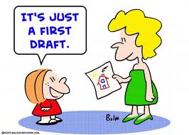
Drafting
The best advice about drafting is to “be flexible”.
Writing is such a cognitively difficult task that it is better to concentrate only on certain things at a time.
The following suggestions can help draft of messages as effectively as possible:
Avoid perfectionism When Drafting
Keep Going
Use any other strategies that will keep working productively

Slide 13
Drafting
☞ Avoid perfectionism when drafting:
Avoiding perfectionism helps to include all important information and makes to more willing to revise.
Trying to male first draft a perfect draft cause two problems.
First, spending too much energy perfecting the early parts can make to forget important pieces and purposes of the later parts.
Second, premature perfectionism can make drafting frustrating and slow, thus keeping one from wanting to revise the message when one has done.

Slide 14
Drafting
☞ Keep Going:
Keep going, making each statement just good enough to let one move on.
When turning a planning into a draft, generate the first version of the document.
Have an understanding that one will draft relatively quickly, to get the ideas down on paper or onto the screen, and then go back and carefully revise.
Expressing the points in a somewhat coherent, complete, and orderly fashion is hard enough.

Slide 15
Drafting
☞ Use any other strategies that will keep you working productively:
The idea with drafting is to keep moving forward at a reasonably steady pace with as little agonizing as possible.
The goal is to get the first orderly expression of the planned contents written out just well enough so that one can go back and work with.

Slide 16
Revising
Revision requires going back over to message carefully- several times.
There are so many facets to any given message that it can help to use what professional writers call “levels of edit.”
There are three main levels of edit, commonly referred to as
Revision
Editing
Proofreading

Slide 17
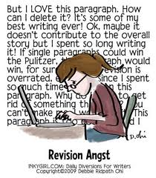
Revising
☞ Revision:
With revision one should look at top-level concerns: whether or not one included all information, If the pattern of organization is logical and as possible, if the overall meaning of the message comes through, if the formatting is appropriate and helpful.
The three main levels are
revision of contents,
organization and
format.

Slide 18
Revising
☞ Editing:
In the editing level, focusing on the style.
Examine the sentences to see if they pace the information in such a way that the reader can easily follow it, if they emphasize the right things, and if they combine pieces of information coherently.
In editing the writer should edit the sentences and words.

Slide 19
Revising
Proofreading:
Finally, proofread, looking at particular mechanical and grammatical elements-spelling, typography, punctuation, and any particular grammar problems that tend to give trouble.
Editing functions of word-processing program can help to do this task.
Careful attention to each level will result in a polished, effective message.

Slide 20
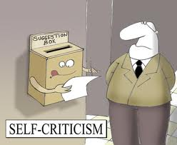
Revising
One last word about revision: Get feedback from others.
Seek out assistance from willing friends, and if they give criticism, receive it with an open mind.
Better to hear it from them, not from intended readers, when costly mistakes may have already been made.

Slide 21
The Importance of Readable Formatting
If you want your readers actually to read what you wrote and get your ideas and information, you must pay attention to an important element of any message: it’s physical format.
Do not put off your readers with a daunting physical format.
The writer is responsible for making the important formatting decisions.
An attractive, readable, format is critical to any message’s success.

Slide 22
Letters
Letters are the traditional form of business messages.
The early civilizations used them.
We should know about the letter purpose, format, and composition.
The general purpose of a letter is to represent the writer and his/her topic rather formally to the recipient.
For this reason, letters are used primarily for corresponding with people outside the organization.
Letters are primarily for external audience.

Slide 23
Letters
In the early days emphasis was on word choice, especially on use of a stiff and stilted manner of expressing courtesy.
Current techniques of composing business letters have been developed by various business scholars and leaders.
In recent times emphasis shifted to structured and strategy of content and humanness of wording.
Despite its heightened formality, the letter should always be regarded as an exchange between real people as well as a strategic means for accomplishing business goals.

Slide 24
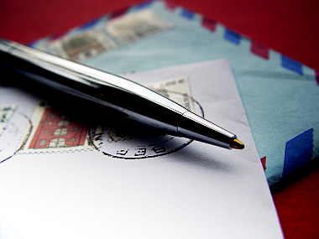
What is a Business Letter?
✦ A Business Letter is a letter written in formal language, usually used when writing from one business organization to another, or for correspondence between such organizations and their customers, clients and other external parties.

Slide 25
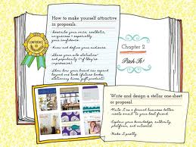
Types of Business Letters
Letter of Transmittal: A transmittal letter is a brief business letter sent along with another type of communication, such as a longer document like a proposal, a response to an inquiry or a payment. It provides a way to let the recipient understands what is being sent, why they received it and who it is from.
Letter of Thanking
Letter of Request
Response to a Letter of Request
Inquiry letters
Sales letters
Customer relations letters:
– Follow-up
– Complaint
– Adjustment
– Collection

Slide 26
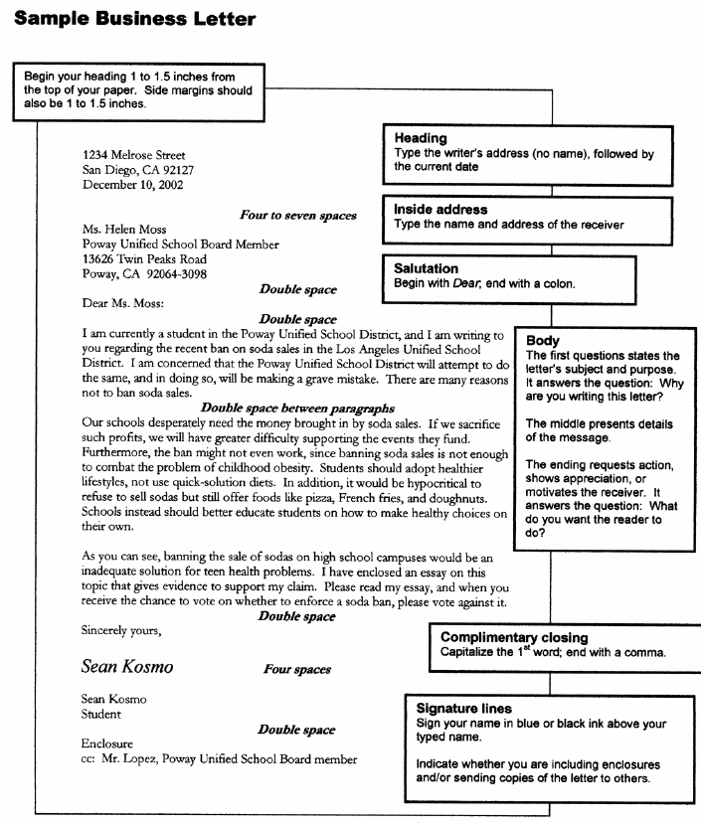
1. Margins: the space around your letter.
Go to “File.”
Scroll down to “Page Set-Up”
On the “Margins” Tab, Put “1-Inch” for the top, bottom, left, and right margins.

Slide 27
2. You need your own address.
This part goes in the “heading” section.
Underneath your address, put the date.
Skip four lines.

Slide 28
3. Put the organization’s address in the “inside address” section.
Double space.

Slide 29
4. Salutation/Greeting
Dear Ms. Smith (or whoever is the head of your organization)
Use Ladies and Gentlemen when name is unknown
Double space.

Slide 30
5. Body: State your purpose for writing this letter. Be formal and polite; the organization is doing YOU a favor by sending you the information.

Slide 31
You may or may not have more than one paragraph. If you do, between each paragraph, be sure to double space.

Slide 32
6. Closing: Yours Sincerely
Four spaces after the closing
Then your name. In between the closing and your name, that is where you would sign your name.

Slide 33
Letters
○ The format of business letter varies but some variations in format are generally acceptable, typically these information items are included:
Date,
Inside address,
Salutation (Dear Mr. Rahman),
Body and
Complimentary close (Sincerely yours).
○ Other items sometimes needed are
Attention line,
Subject line, return address (When letterhead paper is not used), and
Enclosure information.

Slide 34
Mechanical Structure of a letter
 Inside Address:
– The inside address contains the name and address of the firm or the individual to whom the letter is written.
– Inside address should be written below the reference line. Outside address on the envelop is to be written in full while the inside address may be written in behalf.
✓ Outside Address
Mahbuba Sultana
Northern university Bangladesh
Hs-54; Rd-4/A
Satmosjid Road, Dhanmondi
Dhaka-1209
✓ Inside Address
Mahbuba Sultana
Northern university Bangladesh
Dhanmondi

Slide 35
Memorandums
Memorandums (memo) are a form of letter written inside the business.
In rare cases, they may be used in communicating outside the business.
Memos are internal letters- Email is taking over their functions.
“A note to remind something is memorandum”
○ It is clear that office memorandum is a note that assists the memory of officials.

Slide 36
Memorandums
 Its Movement:
A memo is a means of internal communication.
It is used for communication between officers (executives) and subordinates or between officers of the same level within the same organization.

Slide 37
Memorandums
 Its Use:
Giving instructions to the staff;
Communicating policy changes to the staff;
Giving/seeking advice, suggestions;
Requesting help or information;
Confirming a decision;
Intimating, granting or withholding permission to do something;
Seeking explanation on some matter of conduct and so on.

Slide 38
Memorandums
Determining Memorandum Form:
Most large companies use standard memo templates or printed memorandum stationary with-
Date
To
From and
Subject Heading.
○ Some larger companies have additional headings-
[Department, Plant, Territory, Store Number, and such]

Slide 39
Memorandums
Illustration of good form for the memorandum using the MS word professional templates
Northern University Bangladesh
Internal Office Memo
To:
From:
Cc:
Date:
Subject: ………………………………..
. ………………………………
……………………………….
……………………………….
……………………………….
3. ……………………………….

Slide 40
Memorandums
Memorandum stationary with special headings adapted to the needs of an organization with multiple locations.
Northern University Bangladesh
Memorandum
To: Date:
Store: From:
At: Store:
Territory: At:
Copies to: Territory:
Subject : New working hours.
During the winter from January to March working hours will be amended from 08.30 a.m. to 05.00 p.m. for the BBA program and 05.30 p.m. to 08.30 p.m. for the MBA program.
We hope this new working hours during this winter season will be convenient for you.
Head of the department Dean
Faculty of Business Faculty of Business

Slide 41
Memorandums
○ Advantages of Memo Form:
It is very brief, containing only the messages;
It is convenient;
It is cheap;
It can be use for future reference.
○ Writing Memorandum:
Short, simple memos are often written in casual or informal language, much like short, simple email messages.
Formal memorandums are appropriately organized in the patterns appropriate for longer.

Slide 42
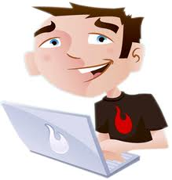
EMAIL
○ Electronic mail: (computer science) a system of world-wide electronic communication in which a computer user can compose a message at one terminal that can be regenerated at the recipient's terminal when the recipient logs in.

Slide 43
EMAIL
○ E-mail: For the operation of e-mail, both the communicator and communicatee must have the facility of two-computer terminals connected on networks.
1. A system for sending and receiving messages electronically over a computer network, as between personal computers.
2. A message or messages sent or received by such a system.

Slide 44
Email
Under email system, a communicator types a message on his/her computer, edits, or rewords it as many times as s/he likes without wasting any time.
Electronic mail is used not only for external communication, but it is also used for internal communication.
In its absence the manager would have to resort to hand delivery of the message to the various recipients.

Slide 45
Email
Evaluating Email’s Pros and Cons:
Among the reasons, the following are most significant:
Email eliminates “telephone tag”-the problem of trying to contact busy people who are not always available for telephone calls.
Email saves the time of these busy people.
Facilitates fast decision because it permits rapid exchanges from all involved in the decisions.
Email is cheap. It permits unlimited use at no more than cost of an internet connection.
It provides a written records.

Slide 46
Email
Email also has its disadvantages.
The following stand out:
Email is not confidential.
Email doesn’t communicate the sender’s emotion well.
Email may be ignored or delayed. The volume of email often makes it difficult for some respondents to read and act on all of their messages.

Slide 47
Email
Including the Prefatory Elements:
The various email systems differ somewhat, the elements are standardized.
They include the following parts:
To: here the sender places the email address of the recipients. It must be perfect, for any error will result in failure to reach the recipient.
Cc: if someone other than the primary recipient is to receive a courtesy copy, his or her address goes here.

Slide 48
Email
Bcc: this line stand for blind courtesy copy. The recipient’s message will not show this information; that is, s/he will not know who else is receiving a copy of the message.
Subject: this line describes the message as precisely as the situation permits. The reader should get from it a clear idea of what the message is about.
Attachments: in this area one can enter a file that one desire to send along with the message.

Slide 49
Email
 As will be emphasized later, one should make certain that what you attach is really needed.
The Message: the information one is sending goes here.
Beginning the Message:
Begin with the recipient’s name or a greeting.
If normally address the reader as Ms., Dr., Mr., and such, address him/her this way in an initial email.
A friendly generic greeting such as “Greetings” is appropriate for a group of people with whom its communicate.

Slide 50
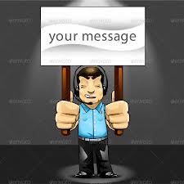
Email
Use of the recipient’s full name also is acceptable.
When writing to someone or a group you do not know, it is appropriate to identify yourself early in the message.
This identification may include the purpose and your company.
Your title and position also may be helpful.

Slide 51
Email
❑ Organizing the Contents:
Even though email messages often are written under time pressure, it should do well to organize them carefully.
Organize short messages by presenting information in descending order of importance.
For most short, informative messages, a “top-down” order is appropriate.
Longer, more complex, and formal email messages frequently follow more involved and strategic organization patterns.

Slide 52
Email
In general, those messages that are likely to be received positively or neutrally are written in a direct pattern.
Those messages that are likely to be received negatively are appropriately written in an indirect pattern.
Some memorandums are communicated by email.
The variety of email messages covers the entire spectrum of written business communication.

Slide 53
Email
❑ Writing the Email Message: Formality Consideration:
A review of email writing is complicated by the fact that email messages are extremely diverse.
Email messages range from highly informal to formal.
Email messages are often written in a fast-paced environment with little time for deliberation.
One approach is to view the language used from three general classifications:
Casual; Informal and Formal

Slide 54
Email
 Casual: by casual language we mean the language we use in talking with close friends in everyday situations.
Casual language uses slang, colloquialisms, contractions.
It uses contractions and personal pronouns freely.
Its sentences are short-sometimes incomplete.
Casual language is best limited to communications with close friends.

Slide 55
Email
Hi Lubna,
What’up? There was a call from Mr. Rahman. He likes our marketing plan and he wanted to meet us for our next dealings. ASAP, they said.
Lets meet @ my cabin, 10 a.m., Wed?
Faria

Slide 56
Email
Most of the personal email (messages to the friends) are likely to be casually written.
This is the way friends talk, and their email should be no different.
It should be wise to use casual language only when you know your readers well- when you know they expect and prefer casual communication.
Never should use slang, initialisms, emphasis
devices, or such that are not certain to communicate clearly and quickly.

Slide 57
Email
 Informal:
Informal language retain some of the qualities of casual writing.
It makes some use of personal pronouns and contractions.
Its sentences are relatively short.
Informal language resembles proper conversation.
Its sentences are short- but they are well structured and organized. They have varied patterns that produce an interesting literary style.
You should use it in most of your business email messages, especially when writing to people you know only on a business basis.

Slide 58
Email
Lubna,
The management team of square has heartily approved our marketing plan. They were most complimentary. But as you predicted, they want a special plan for the large accounts.
As they want it as soon as possible, lets get together to work on it. Can we meet Wednesday, 10 a.m., my office?
Faria

Slide 59
Email
 Formal: a formal style of writing maintains a greater distance between writer and reader than informal style.
It avoids personal references and contractions.
Its sentences are well structured and organized.
Although there is a tendency to create longer sentences in formal writing, this tendency should be resisted.
It is appropriate to use in email messages resembling formal reports, in messages to people of higher status, and to people not known to the writer.

Slide 60
Email
Writing the Email Message: General Consideration
For the purpose of email writing, we may group the more important of these instructions under four heads:
 Conciseness: email often is written by busy people for busy people.
In the best interests of all concerned, email messages should be as short as complete coverage of the subject matter will permit.
This means culling the out the extra information and using only what which is essential.
Minimize references to previous communications.

Slide 61
Email
 Clarity: use the techniques of clear writing.
Especially important in email writing is clarity of wording.
One should select words that quickly create clear meanings.
Typically, these are the short, familiar ones. You should strive for concreteness, vigor and precision.
The sentences should be short and so should the paragraphs.

Slide 62
Email
 Etiquette: it goes without saying that courtesy should be practiced in all business relations.
We all want to receive courteous and fair treatment.
Good email etiquette should prevail.
The skillful use of positive language and viewpoint also can be effective in email.
Virtually all the instructions given on principles of business letter writing apply here.

Slide 63
Email
 Correctness: one would think that the need for correctness in email writing would be universally accepted.
Unfortunately, such is not the case, because of the fast pace of email communication, some practitioners argue that, “getting the message out there” is the important goal- the style need not be a matter of concern.
Bad spelling, illogical punctuation, awkward wording should be avoided.
To avod any such suggestions of ignorance, one should follow the grammatical and punctuatuin instructions.

Slide 64
Email
○ Closing the Email Message:
Most email message end with just the writer’s name-the first name alone if the recipient knows the writer well.
“Thanks” and “Regards” are popular.
It is important that you include your company and position.
Today most email software has a signature that will automatically attach signature file to a message.

Slide 65
Email
Using Emphasis Devices in Email:
Email has limited use of emphasis devices.
These substitutes have been developed.
When you write email message, you my find that certain elements of style are missing either on your system or on your reader’s system.
While most of the current versions of Windows and Macintosh email programs support mechanical devices such as underscoring, font variations, italic, bold, color, and even graphics.

Slide 66
Email
Using Initialisms Cautiously:
Initialisms have been developed to save time.
But use them cautiously.
ASAP: as soon as possible.
BTW: by the way.
FWIW: for what it’s worth.
FYI: for your information.
IMHO: in my humble opinion.
LOL: laughing out loud.
TIA: thanks in advance
TTFN: ta ta for now.

Slide 67
Email
Avoiding Inappropriate use of Email:
Don’t use email when the message involves these aspects:
The message is long, complicated or requires negotiation.
Need clarification and discussion.
Information is confidential or sensitive, requires security, or could be misinterpreted.
The message is sent to avoid the contact with a direct person.

Slide 68
Text Messaging
○ It is widely used, especially by young people.
Text messaging, also called short message service (sms), allows one to use a mobile phone to send, receive, and view short messages using the phone's keypad and screen.
It enables one to send and receive short messages by wireless phones and personal computers.
Although text messaging currently is used primarily for personal communications, it is beginning to find a place in business communication.

Slide 69
Text Messaging
○ The writing of text messages is quite different from that of other message.
⇦ Some examples:
b4: before; u: you; gr8: great; np: no problem; cu: see you.
⇦ Use of smileys:
:) (standard smiley); :-( ( sad or frown)
:-! (foot in mouth); :-0 (yell)
:*) ( drunk smile); (((H))) (hugs)
○ While text messaging is relatively new for business use, you will find it a valuable too if your messages are clear, complete and concise with a pleasant and professional tone.

Slide 70
Instant Messaging
Another popular kind of electronic message is instant messaging.
Commonly referred to as IM-ing, instant messaging, or online chatting, is much like a telephone conversation.
It differs primarily in that it uses text-based (typed) rather than voice-based communication, although recent developments have made voice-based instant messaging possible.

Slide 71
Instant Messaging
With some exceptions, in instant messaging both parties are logged into their instant message server at the same time.
If the person is a personal friend, language should reflect the friendship.
If the person is the president of your company, a business associate, or a fellow worker, this relationship should guide the language.
Instant messaging can be monitored, companies often use enterprise instant messaging software to monitor and log employee instant messaging.

Slide 72

Thank You

